Slide 1
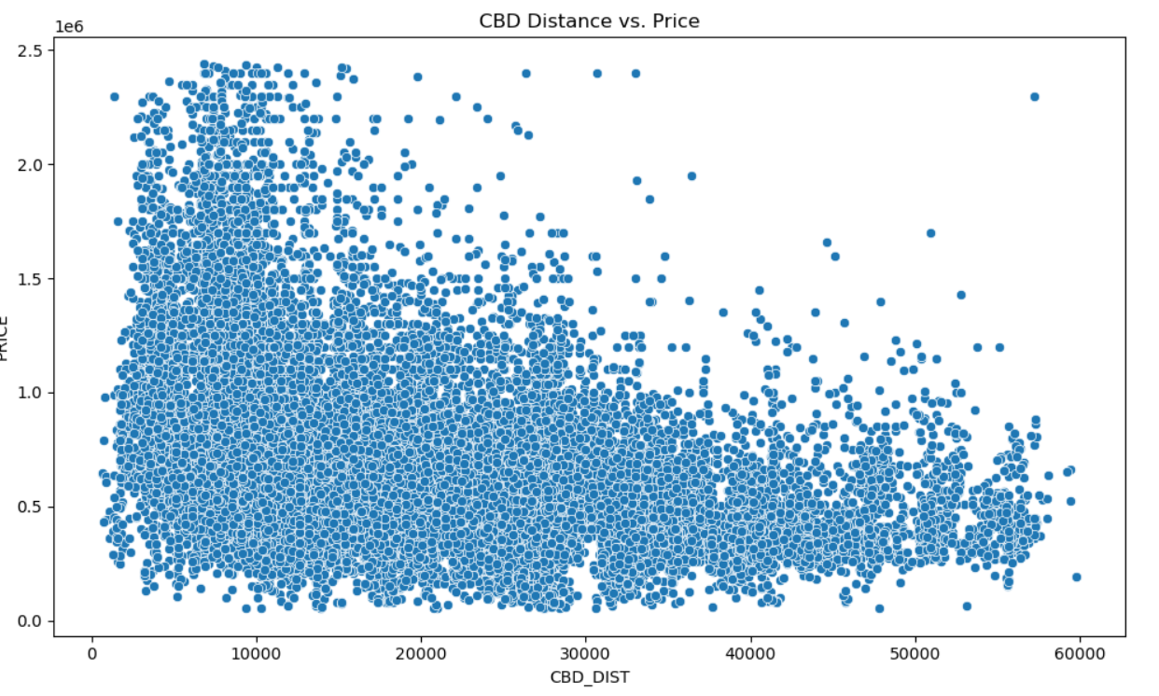
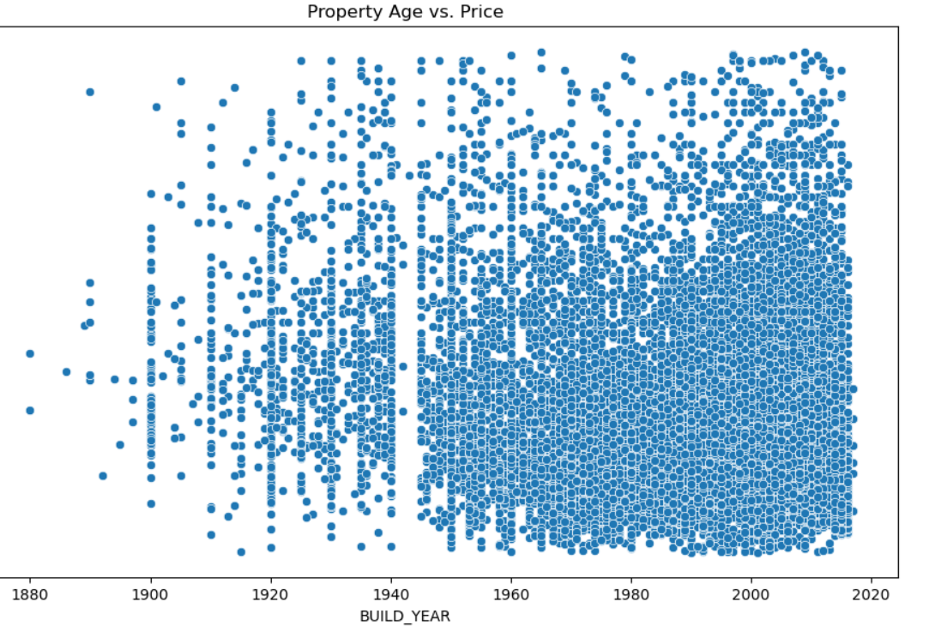
How does the age of a property and its distance from the CBD relate to its selling price?

Slide 2
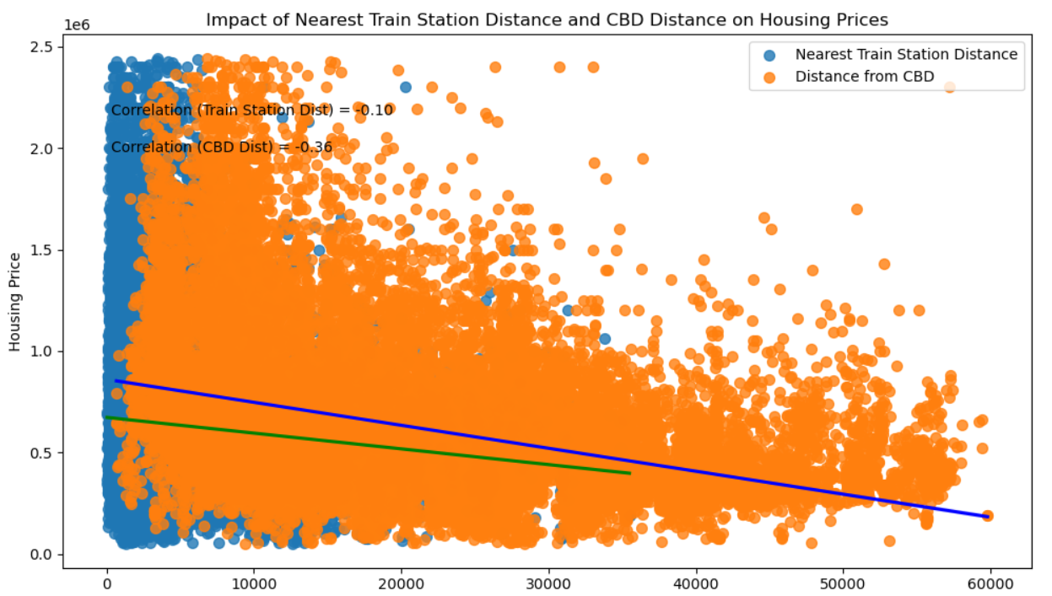
Impact of Train Station and CBD distance on Housing Price

Slide 3
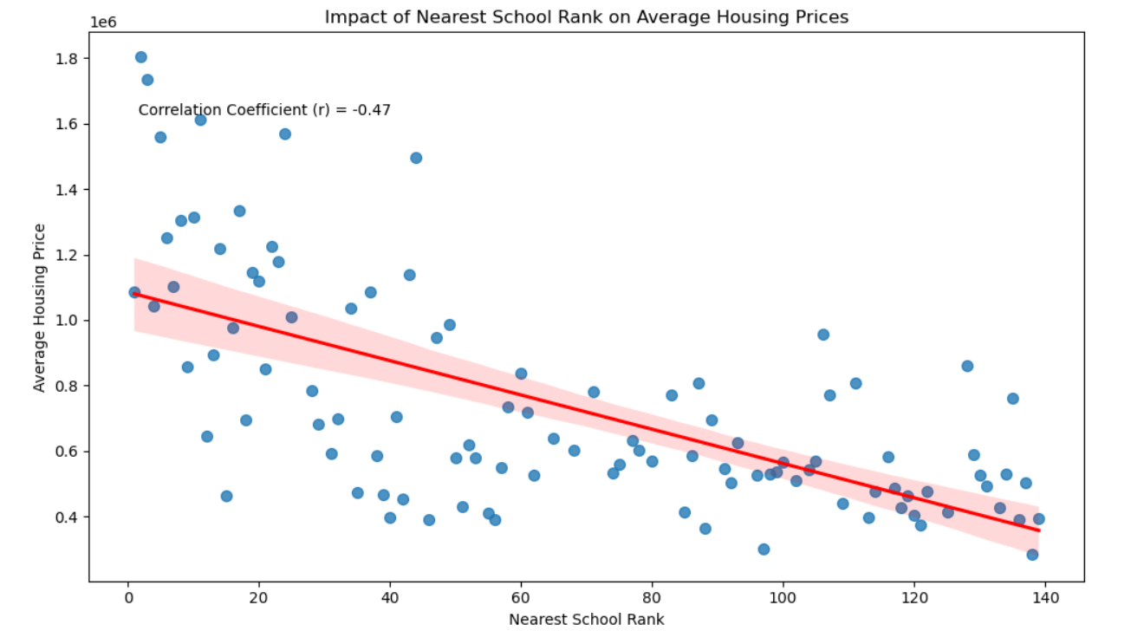
School Distance and Housing Price

